Slide 1

Pre Meeting Session
August 14, 2019
Trent Knoles (IL)
IFTA, Inc. Board of Trustees
Craig Lyon (SK)
IFTA, Inc. Board of Trustees

Slide 2
IFTA BASICS

Slide 3
What is IFTA?
The International Fuel Tax Agreement
A tax collection agreement by and among the 48 contiguous States and the 10 Canadian Provinces bordering the US
Uniform administration of motor fuels use taxation laws with respect to qualified motor vehicles operated in more than one member jurisdiction

Slide 4
IFTA’s Core Principals
Base Jurisdiction
Retention of Sovereign Authority to determine tax rates, exemptions and exercise other substantive tax authority
Uniform Definition of Qualified Motor Vehicle

Slide 5
Base Jurisdiction
Where qualified motor vehicles are registered (IRP)
Where operational control and operational records are maintained or can be made available
Where some travel is accrued

Slide 6
Tax Collected Through IFTA
Motor fuel use taxes that are imposed by each jurisdiction on the consumption of motor fuel in qualified motor vehicles.

Slide 7
Qualified Motor Vehicle
Motor vehicle used, designed or maintained for the transportation of persons or property and
Gross vehicle or registered gross vehicle weight over 26,000 lbs. or 11,797 kgs.
Three-axles regardless of weight
Used in combination when the weight of the combination exceeds 26,000 lbs. or 11,797 kgs.

Slide 8
Who May License
Any person based in a member jurisdiction operating a qualified motor vehicle in two or more member jurisdictions

Slide 9
Benefits to the Licensee
One license and one set of decals for each qualified motor vehicle to operate through all member jurisdictions
One tax return filed each quarter with the base jurisdiction
One tax payment or refund
One audit by the base jurisdiction
Reduced administrative costs

Slide 10
Benefits to the Jurisdiction
Fewer taxpayers
Lower administrative costs
Increased audit coverage
Increased enforcement

Slide 11
ACTIVE MEMBERSHIP STATUS

Slide 12
ACTIVE MEMBERSHIP STATUS
(R1545)
To retain active membership status, the jurisdiction must:
Collect and transfer fees for other jurisdictions in a timely manner;
Pay membership fees in a timely manner; and
Comply with all other provisions of the Agreement.
Voting privileges are granted only to members holding active status

Slide 13
ACTIVE MEMBER PARTICIPATION
Comment and vote on ballots
Update jurisdiction information on the IFTA, Inc. web site (www.iftach.org)
Update your staff and jurisdiction on IFTA issues and notices from other jurisdictions
Serve on committees
Participate on Compliance Reviews

Slide 14
Role of Membership in Meetings

Slide 15
Participate
Share your knowledge:
  Discussing items as they arise during the meeting i.e.
        Town Hall
        Ballots
        Presentations
  Ask Questions of fellow jurisdictions
        If you are having an issue, another jurisdiction most likely is or has had a similar issue.

Slide 16
Get Involved
Join or allow staff to become members of a committee and be involved with committee work etc.
Committees
  Audit Committee
  Agreement Procedures Committee
  Dispute Resolution Committee
  Clearinghouse Advisory Committee
  Law Enforcement Committee
  Program Compliance Review Committee
  Industry Advisory Committee

Slide 17
Networking
  Introduce yourself to fellow jurisdictions in attendance.
  Board Members
  IFTA Staff
  Industry Representatives

Slide 18


Ballot Commenting & Voting
Comment
      During the comment period your comments
      on ballots help the sponsor improve the ballot
      and address issues.
Vote
      Ballots only succeed or fail by voting to support your jurisdiction needs.
      Non-Vote counts as a no vote.
      Short Track ballots can not move on from ABM without a vote.
      CBI’S are brought to ABM and voted on to help clarify parts of the Agreement, Procedures and Audit manuals when there is confusion.
      Elect Board Members

Slide 19
Working Together
IFTA only continues to be a
SUCCESS
by working together.

Slide 20
IFTA, Inc.
Board of Trustees

Slide 21
The Board of Trustees
Established by Article 4 of the Bylaws of the International Fuel Tax Association, Inc.
Consists of nine members
Must be a Commissioner or designee
Serve staggered two year terms
Must attend regular meetings

Slide 22
The Board of Trustees
Basic Functions
Manage the affairs of IFTA, Inc. including:
Approve the financial plans of the Association
    Contracts – Loans – Investments - Revenue - Expense
Oversee Committee Operations
  Board Liaisons ensure Committee’s function within Agreement mandates and Board charges
  Appoint Committee Chairs and approve members
Plan and conduct Annual Business Meeting

Slide 23
The Board of Trustees
Manage the affairs of IFTA, Inc. (Cont.):
Create and maintain the Strategic Plan
Establish Special Committees and direct activities
Serve as the appellate body for appeals to actions of the Dispute Resolution Committee

Slide 24
Bylaws are found on the
IFTA, Inc. Web site

Slide 25
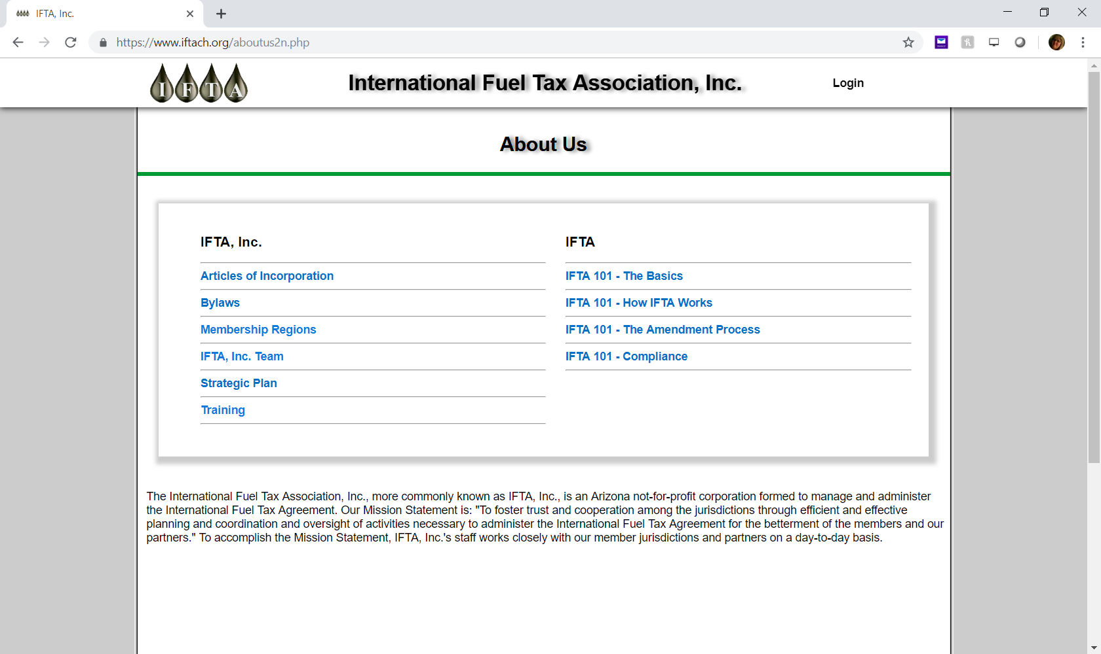

Slide 26
Board Members
Executive Committee
    Stephen Nutter, President
      Virginia Department of Motor Vehicles – Southeast Region
    Scott Bryer, 1st Vice President
      New Hampshire Department of Safety, – Northeast Region
    Antoinette Tannous, 2nd Vice President
      Revenue Quebec – Canadian Region

Slide 27
Board Members
  Trent Knoles – Midwest Region
  Illinois Department of Revenue
  Craig Lyon – Canadian Region
  Saskatchewan Ministry of Finance
  David Nicholson – Midwest Region
  OK Corporation Commission
  Rodney Richard – Southeast Region
  Arkansas Department of Finance
  L. Michael Romeo – Northeast Region
  Connecticut Department of Revenue Services
  Helen Varcoe – Western Region
  Montana Department of Transportation

Slide 28
Board Current Activities
For all the details of the Board’s activities, go to the IFTA , Inc. web site at
www.iftach.org
The minutes of all Board activities are posted for your review!

Slide 29
IFTA, Inc. Board Members
Elections & Qualifications

Slide 30
IFTA Board Elections & Qualifications
Any commissioner of a member jurisdiction, or their designee, is eligible to serve as a Trustee.
There shall be nine (9) Trustees on the Board.
The term of office for a Trustee shall be two (2) years.
Five (5) Trustees elected in years ending in an odd number.
Four (4)Trustees elected in years ending in an even number, so as to provide for staggered terms of the Trustees.
No Trustee may serve more than three (3) complete two-year consecutive terms.

Slide 31
Qualifications & Requirements
One Trustee shall be from each of the five (5) geographic regions outlined in the bylaws. (Canadian, Northeast, Southeast, Midwest, Western)
No more than two (2) trustees shall be from a single geographic region.
One (1) region represented will only have one trustee rotating among the geographical regions in accordance with the schedule set forth in Appendix A of bylaws.
For 2020 the Midwest will only have one trustee.

Slide 32
Qualifications & Requirements…
One (1) Trustee shall be a member where fuel taxes are administered by a tax or revenue department.
One (1) Trustee shall be a member where fuel taxes are administered by a department of transportation or department of motor vehicles.
One (1)Trustee shall be a woman or minority.
A single Trustee on the Board may satisfy more than one (1) criterion.

Slide 33
Qualifications & Requirements…
The President of IFTA, Inc. shall direct that nominations be sought from member jurisdictions for election to the Board. Nominations, including those for trustees seeking re-election, may be made prior to or from the floor at the Annual Business Meeting.
The President of IFTA Inc. shall each year establish an Election Committee consisting of the Trustees whose terms are not expiring. The Election Committee shall select a Chair.

Slide 34
Qualifications & Requirements…
The duties of this committee are:
  Ensure the Qualifications and Requirements set forth in Article Four Section 3 herein are met.
  Ensure equitable geographic representation is maintained through use of the rotational schedule
  Conduct the election at the Annual Business Meeting.
All nominees for the Board of Trustees will be voted upon by the member jurisdictions at the Annual Business meeting.

Slide 35
Qualifications & Requirements…
At this Annual Business Meeting, elections will be held for five (5) seats on the Board.
Those seats are currently held by Steve Nutter (VA), Trent Knoles (IL), Scott Bryer (NH), Craig Lyon (SK), and Rodney Richard (AR).
Mr. Nutter and Mr. Knoles will complete their third, two-year consecutive terms on December 31, 2019 and cannot seek re-election due to the term limits set within the Bylaws.
The following Regions must be elected:
Canadian – West – Northeast - Southeast (2 seats)

Slide 36
IFTA Amendments

Slide 37
IFTA Amendments
The IFTA Articles of Agreement, R1600 provides that proposals for amendments to the Agreement, Procedures Manual or Audit Manual can be made by:
  Any Member Jurisdiction
  Committees: Agreement Procedures, Audit, Clearinghouse Advisory, Law Enforcement, Program Compliance Review
  The IFTA, Inc. Board of Trustees

Slide 38
IFTA Ballot Process
Sponsors submit Proposals
Proposals distributed for comment period
Proposals discussed at Annual Business Meeting
Sponsors review proposals and may submit revisions
Proposals distributed for second comment period
Sponsors review and may submit revisions
Ballots distributed for vote
All comments and votes are submitted through IFTA, Inc. website

Slide 39
IFTA Ballot Time Frames
Full Track Proposals
First comment period – 45 days
Sponsor review after ABM (unless moved to Short Track at the ABM) – 45 days
Second comment period – 45 days
Voting period – 60 days

Slide 40
IFTA Ballot Time Frames
Short Track Proposals
First comment period – 30 days
Sponsor review after ABM (provided the ballot received sufficient votes to move forward) – 30 days
Second comment period – 30 days
Voting period – 30 days

Slide 41
Annual Business Meeting Protocol
Full Track Ballot Proposals
Full track ballot proposals may be moved to short track – must receive an affirmative vote of ¾ of the member jurisdictions (44) to move to short track – if not, ballot stays on full track and moves forward
Straw Votes:
  Ballot sponsors may request a straw vote to determine the level of support for a ballot proposal
  Not a binding vote
Short Track Ballot Proposals
Short track ballot proposals must receive an affirmative vote of ¾ of the member jurisdictions (44) to continue on the short track – if not, ballot proposal dies

Slide 42
Consensus Board Interpretations (CBI’s)
A process through which provisions of the IFTA governing documents may be interpreted/clarified and commentary added to the affected provisions

Slide 43
Consensus Board Interpretations (CBI’s)
A jurisdiction, committee or Board member may request an interpretation of IFTA requirements as stated in the Agreement, Procedures Manual or Audit Manual
The Board may issue a proposed interpretation
A proposed interpretation must be ratified by ¾ affirmative vote of the membership (44) at an Annual Business Meeting
If ratified, commentary is added to the affected IFTA governing document & is binding on all jurisdictions

Slide 44
IFTA Bylaws
IFTA Bylaws require an annual meeting to conduct business, elect trustees to the Board
IFTA Bylaws govern voting requirements (along with the IFTA Agreement)
Amendments to the Bylaws require a majority of votes (39) (per the IFTA Articles of Incorporation)

Slide 45
Committees
Roles and Responsibilities

Slide 46
Committees
Agreement Procedures Committee
Audit Committee
Clearinghouse Advisory Committee
Dispute Resolution Committee
Industry Advisory Committee
Law Enforcement Committee
Program Compliance Review Committee

Slide 47
Agreement Procedures Committee (APC)
COMMITTEE RESPONSIBILITIES: The APC is responsible for reviewing the IFTA Articles of Agreement, the IFTA Procedures Manual and making recommendations for changes as needed, and other duties assigned to it by the Board. Additionally the APC is responsible for:
A. planning and participating in the annual Managers/Law Enforcement
Workshop,
B. reviewing and commenting on ballot proposals,
C. reviewing and preparing responses for consensus board interpretation drafts
referred to it by the Board,
D. developing ballot proposals and Board interpretation requests,
E. maintaining a committee member rotation chart,
F. recruiting members and maintaining a list of potential committee members,
G. making recommendations to the Board to fill committee vacancies; and
H. maintaining the IFTA Best Practices Administrative Guide.

Slide 48
Audit Committee (AC)
COMMITTEE RESPONSIBILITIES: The AC is responsible for reviewing the IFTA Audit Manual and making recommendations for changes as needed, and other duties assigned to it by the Board. Additionally the AC is responsible for:
A. advising the IFTA membership regarding audit matters;
B. planning and conducting an annual audit workshop;
C. reviewing and commenting on ballot proposals,
D. reviewing and preparing responses for consensus board interpretation drafts
referred to it by the Board,
E. developing ballot proposals and Board interpretation requests,
F. maintaining a committee member rotation chart,
G. recruiting members and maintaining a list of potential committee members,
H. making recommendations to the Board to fill committee vacancies; and
I. maintaining the IFTA Best Practices Audit Guide.

Slide 49
Clearinghouse Advisory Committee (CAC)
COMMITTEE RESPONSIBILITIES: The CAC has the responsibility of advising the Board and the Executive Director of IFTA, Inc. of business rules for the operation of the Clearinghouse including consistency of submitted data, timeliness of the data, type of data allowed or required to be submitted. The CAC helps to ensure that the Clearinghouse operates within the IFTA requirements and that members find the data usable and accessible. The CAC is also responsible for suggesting enhancements to the Clearinghouse. Additionally, the CAC is responsible for:
A. serving as a technical source for membership;
B. maintaining a committee member rotation chart,
C. recruiting members and maintaining a list of potential committee
members, and
D. making recommendations to the Board to fill committee vacancies.

Slide 50
Dispute Resolution Committee (DRC)
COMMITTEE RESPONSIBILITIES: The DRC has the following responsibilities:
A. facilitating resolution of disputes between member jurisdictions,
and between member jurisdictions and licensees;
B. reviewing IFTA’s Dispute Resolution Process and procedures and recommending changes to the International Fuel Tax Association, Inc. (IFTA, Inc.) Board of Trustees (Board), as necessary;
C. maintaining a committee member rotation chart;
D. recruiting members and maintaining a list of potential committee members;
E. making recommendations to the Board to fill committee vacancies.

Slide 51
Industry Advisory Committee (IAC)
COMMITTEE RESPONSIBILITIES: The IAC is responsible for advising and assisting the IFTA, Inc., Board of Trustees (Board) and the other committees formed pursuant to the IFTA Articles of Agreement, and other duties assigned to it by the Board. Additionally the IAC is responsible for:
maintaining a committee member rotation chart,
recruiting members and maintaining a list of potential committee members, and
making recommendations to the Board to fill committee vacancies.

Slide 52
Law Enforcement Committee (LEC)
COMMITTEE RESPONSIBILITIES: The LEC has the responsibility of advising the IFTA membership regarding law enforcement matters and such other responsibilities as specified in the IFTA or assigned to it by the International Fuel Tax Association, Inc. (“IFTA, Inc.”) Board of Trustees (“Board”). Additionally the LEC is responsible for:
in the discharge of its responsibilities, seeking input from other committees formed pursuant to the IFTA,
planning and participating in the annual Managers/Law Enforcement Workshop,
reviewing and commenting on ballot proposals,
developing ballot proposals as appropriate,
maintaining a committee member rotation chart,
recruiting members and maintaining a list of potential committee members,
making recommendations to the Board to fill committee vacancies; and
maintaining the IFTA Best Practices Law Enforcement Guide.

Slide 53
Program Compliance Review Committee (PCRC)
COMMITTEE RESPONSIBILITIES: The PCRC has the responsibility of maintaining the IFTA Program Compliance Review Guide, reviewing all program compliance review reports to determine any needs for follow up or reassessment, to make findings of compliance or non-compliance, and such other responsibilities as specified in the IFTA or assigned to them by the International Fuel Tax Association, Inc. (IFTA, Inc.) Board of Trustees (Board). Additionally the PCRC is responsible for:
A. seeking input from other committees formed pursuant to the IFTA,
B. reviewing and commenting on ballot proposals as appropriate,
C. developing ballot proposals as appropriate,
D. maintaining a committee member rotation chart,
E. recruiting members and maintaining a list of potential committee members,
F. making recommendations to the Board to fill committee vacancies; and
G. establishing and maintaining a pool of qualified individuals to conduct
compliance reviews

Slide 54

Wrap Up and Q & A

